Slide 1
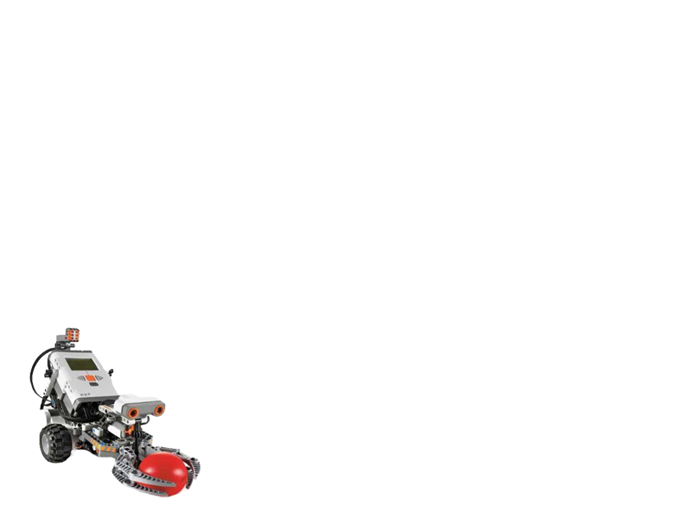
Final Year Project Lego Robot Guided by Wi-Fi (QYA2)
Presented by: Li Chun Kit (Ash)
So Hung Wai (Rex)

Slide 2
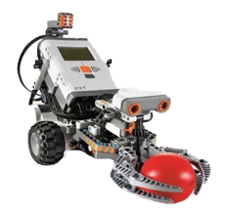
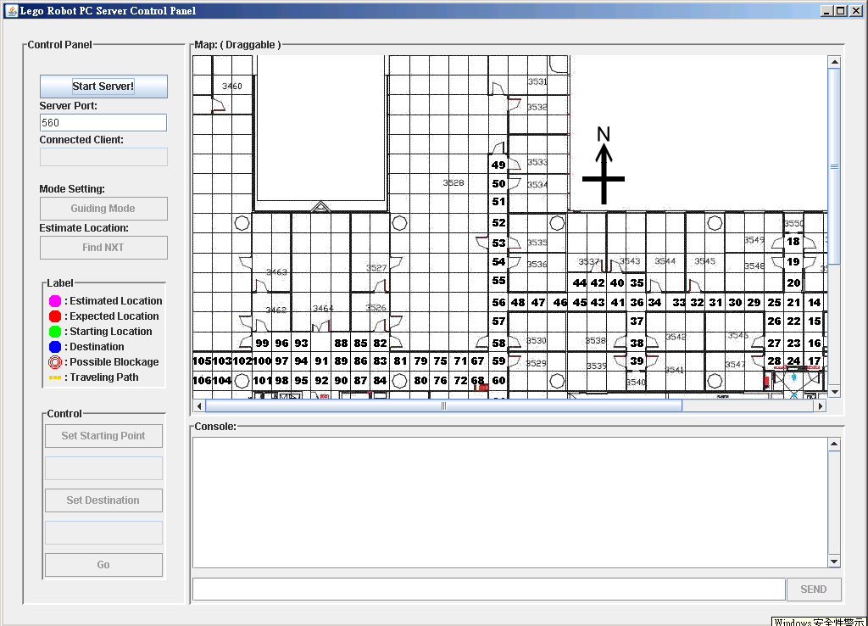
Overview
Introduction
Video Demo
System Functions - Localization - Self-Guiding - Obstacles Detection - Auto Data Collection
Conclusion
Q&A

Slide 3
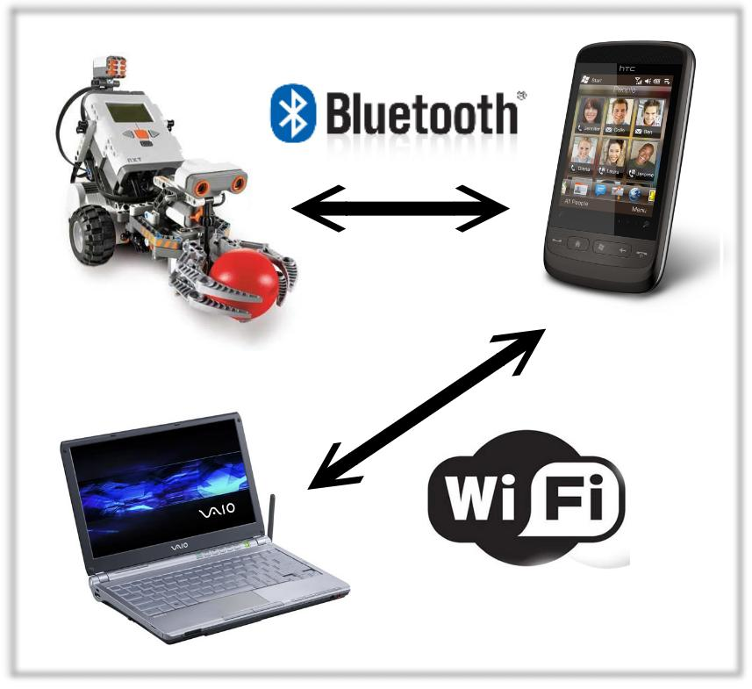
Introduction
Goals
Wi-Fi Indoor localization
Self-Guiding
Lego robot as the media
to move and collect data
automatically
Figure 1. The client-server architecture.

Slide 4
Video Demo

Slide 5
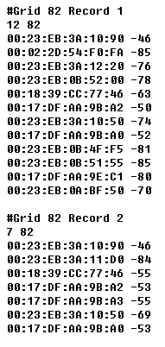
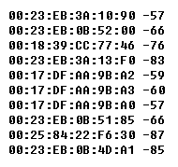
Localization
Offline Phrase | Online Phrase
Data collected for establishing the training database | Observed data is compared with the training database
Figure 3. Observed data received during online phrase.
Machine Learning Algorithm
Estimated Location
Figure 2. Records in training database.

Slide 6

Localization : K-Nearest Neighbor (KNN)
Classification by computing similarity between observed data and records in training database.
For each record in database :
K=10
K=4
Figure 4. For k=4, the user trace is classified to be grid c record; while it is classified to be grid a when k=10.
The grid cell having the highest occurrence in the first k most similar records is the estimated location.
Euclidean Distance
a
Records in grid a, band c
b
c

Slide 7

Localization: Bayesian Probability
Bayesian approach is based on signal strength distribution on each grid cell.
mitigates the random errors
adopts probability measurements
Figure 5. A histogram showing the RSSI distribution of an access point at a grid cell
computes across 106 grid cells

Slide 8
Intuitively
Figure 2. Records in training database.
Bayesian Probability

Slide 9
In Practice
Bayesian Probability
Mac Address |  | RSSI probability
 |  | -60 | -58 | -56 | -54 | ……
 | 00:17:DF:AA:9B:A2 | 0.00 | 0.00 | 0.02 | 0.10 | ……
 | 00:23:EB:0B:4F:F5 | 0.02 | 0.11 | 0.25 | 0.20 | ……
 | 00:23:EB:0B:51:55 | 0.01 | 0.23 | 0.18 | 0.02 | ……
 | …… | …… | …… | …… | …… | ……
Grid Cell 82
RSSI Profiles
Mac Address |  | RSSI probability
 |  | -60 | -58 | -56 | -54 | ……
 | 00:23:EB:0B:4F:F5 | 0.20 | 0.24 | 0.10 | 0.03 | ……
 | 00:23:EB:3A:12:20 | 0.00 | 0.00 | 0.05 | 0.08 | ……
 | 00:17:DF:AA:9E:C1 | 0.01 | 0.02 | 0.13 | 0.18 | ……
 | …… | …… | …… | …… | …… | ……
Grid Cell 83
RSSI Profiles

Slide 10
Algorithm Accuracy

Slide 11
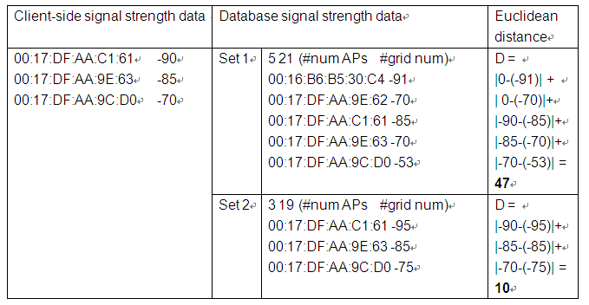
Appendix
KNN Demonstration

Slide 12
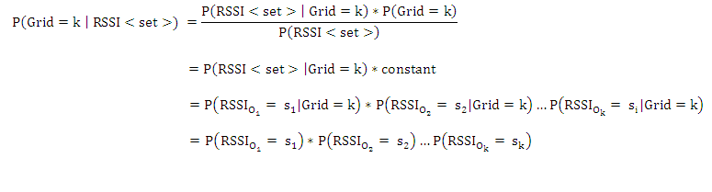
Appendix
Bayesian Formula

Slide 13
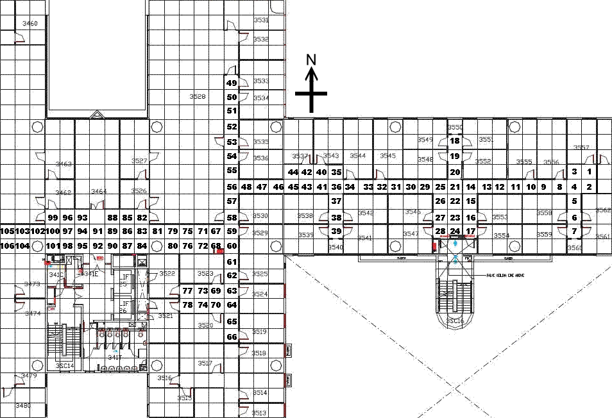
Appendix

